Slide 1
Pathway Analyses in D. Rerio Mecp2 Mutants
KEGG Pathways

Slide 2
Cholesterol Metabolism

Slide 3
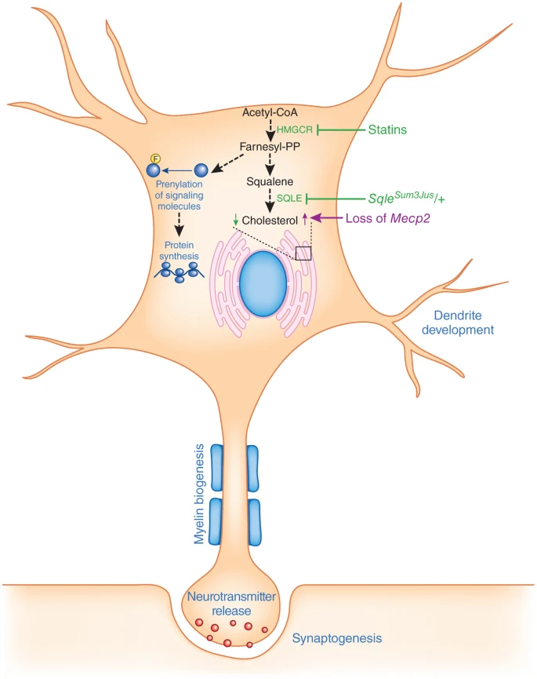
Background
This “study demonstrates that cholesterol homeostasis is disrupted in Mecp2 mutant mice”
“…inhibition (green) of the mevalonate-cholesterol pathway led to amelioration of behavioral and clinical symptoms. Cellular and molecular processes that, on the basis of their known functional connections to cholesterol, may be perturbed by loss of Mecp2 and potentially restored by statins are shown in blue. Farnesyl-PP, farnesyl pyrophosphate.”
Reference: Nagy, G., Ackerman, S. Cholesterol metabolism and Rett syndrome pathogenesis. Nat Genet 45, 965–967 (2013). https://doi.org/10.1038/ng.2738

Slide 4
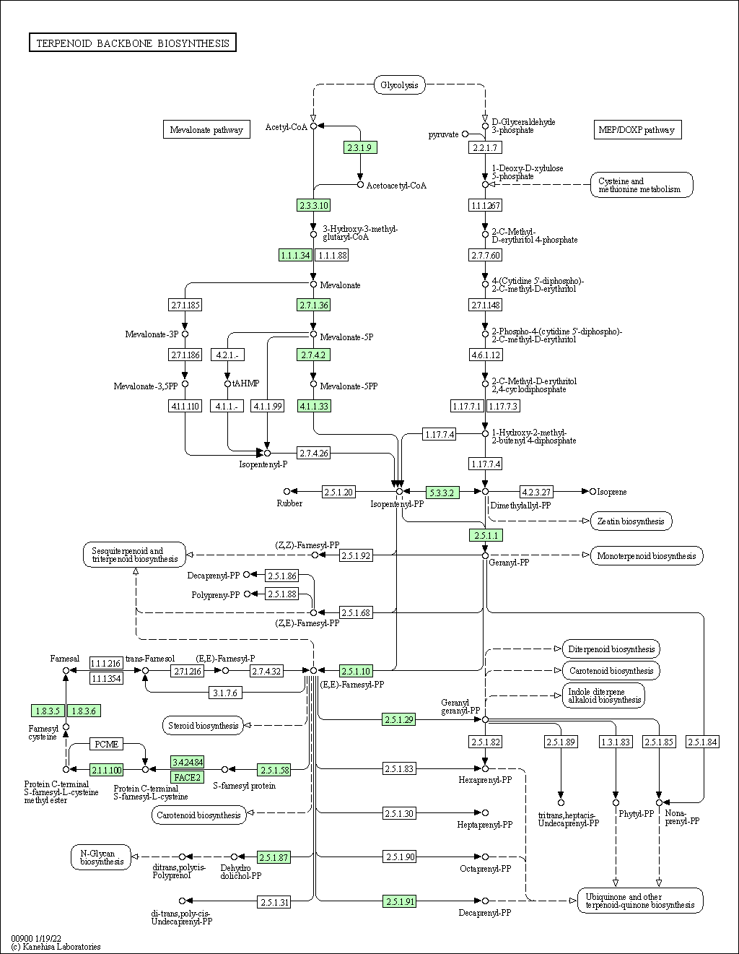
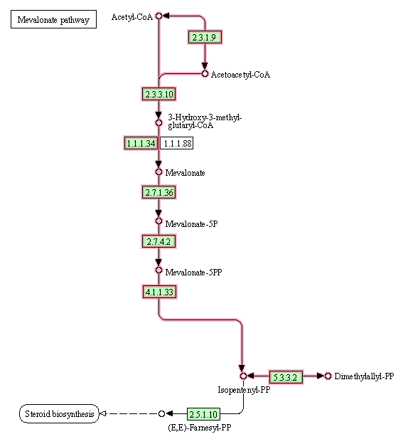
Terpenoid Backbone Biosynthesis
KEGG ID: dre00900
Contains:
Mevalonate Pathway
Connects To:
Steroid Biosynthesis
https://www.kegg.jp/pathway/dre00900+M00095

Slide 5
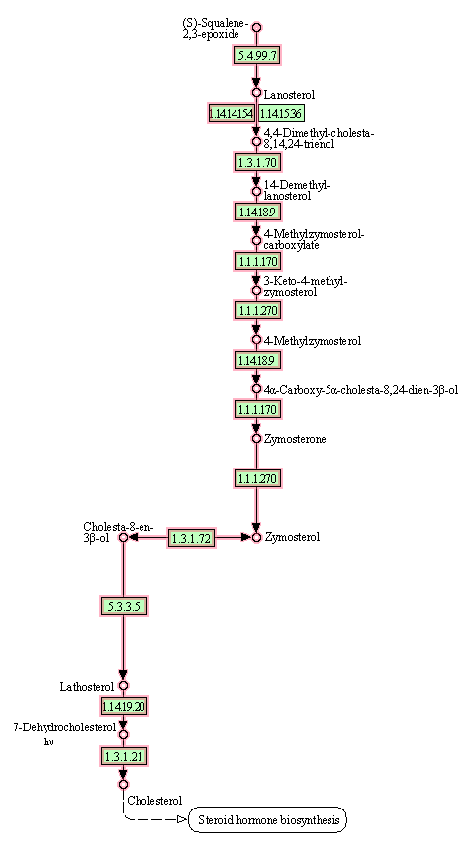
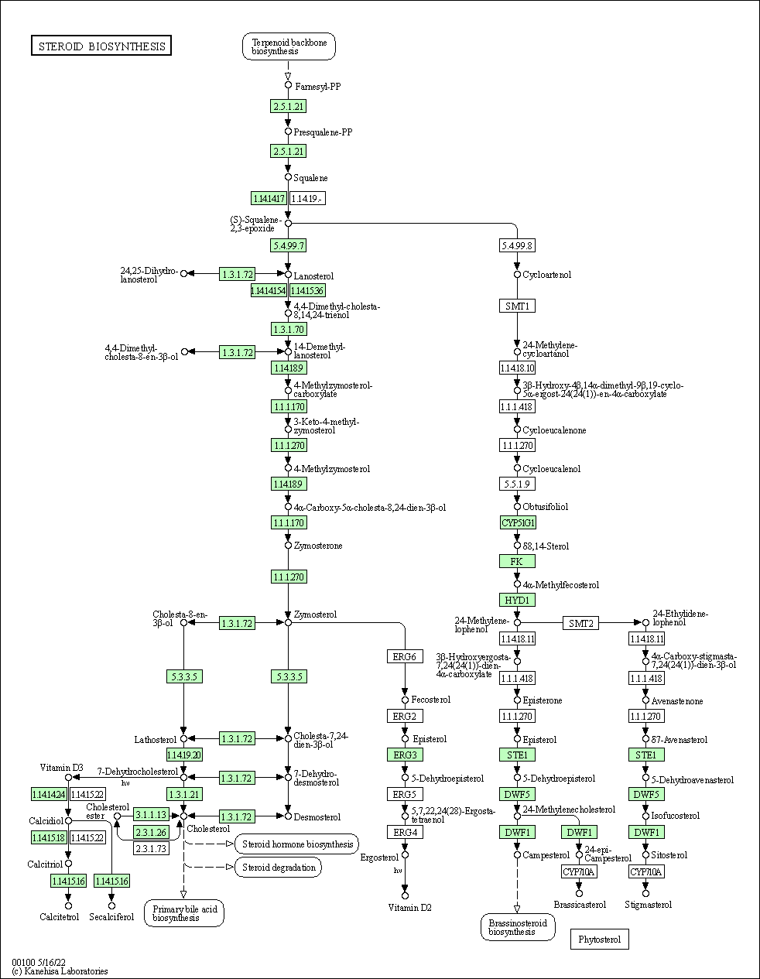
Steroid Biosynthesis
KEGG ID: dre00100
Contains:
Cholesterol Synthesis
Connects To:
Steroid Hormone Biosynthesis Pathway
https://www.kegg.jp/pathway/dre00100+M00101

Slide 6
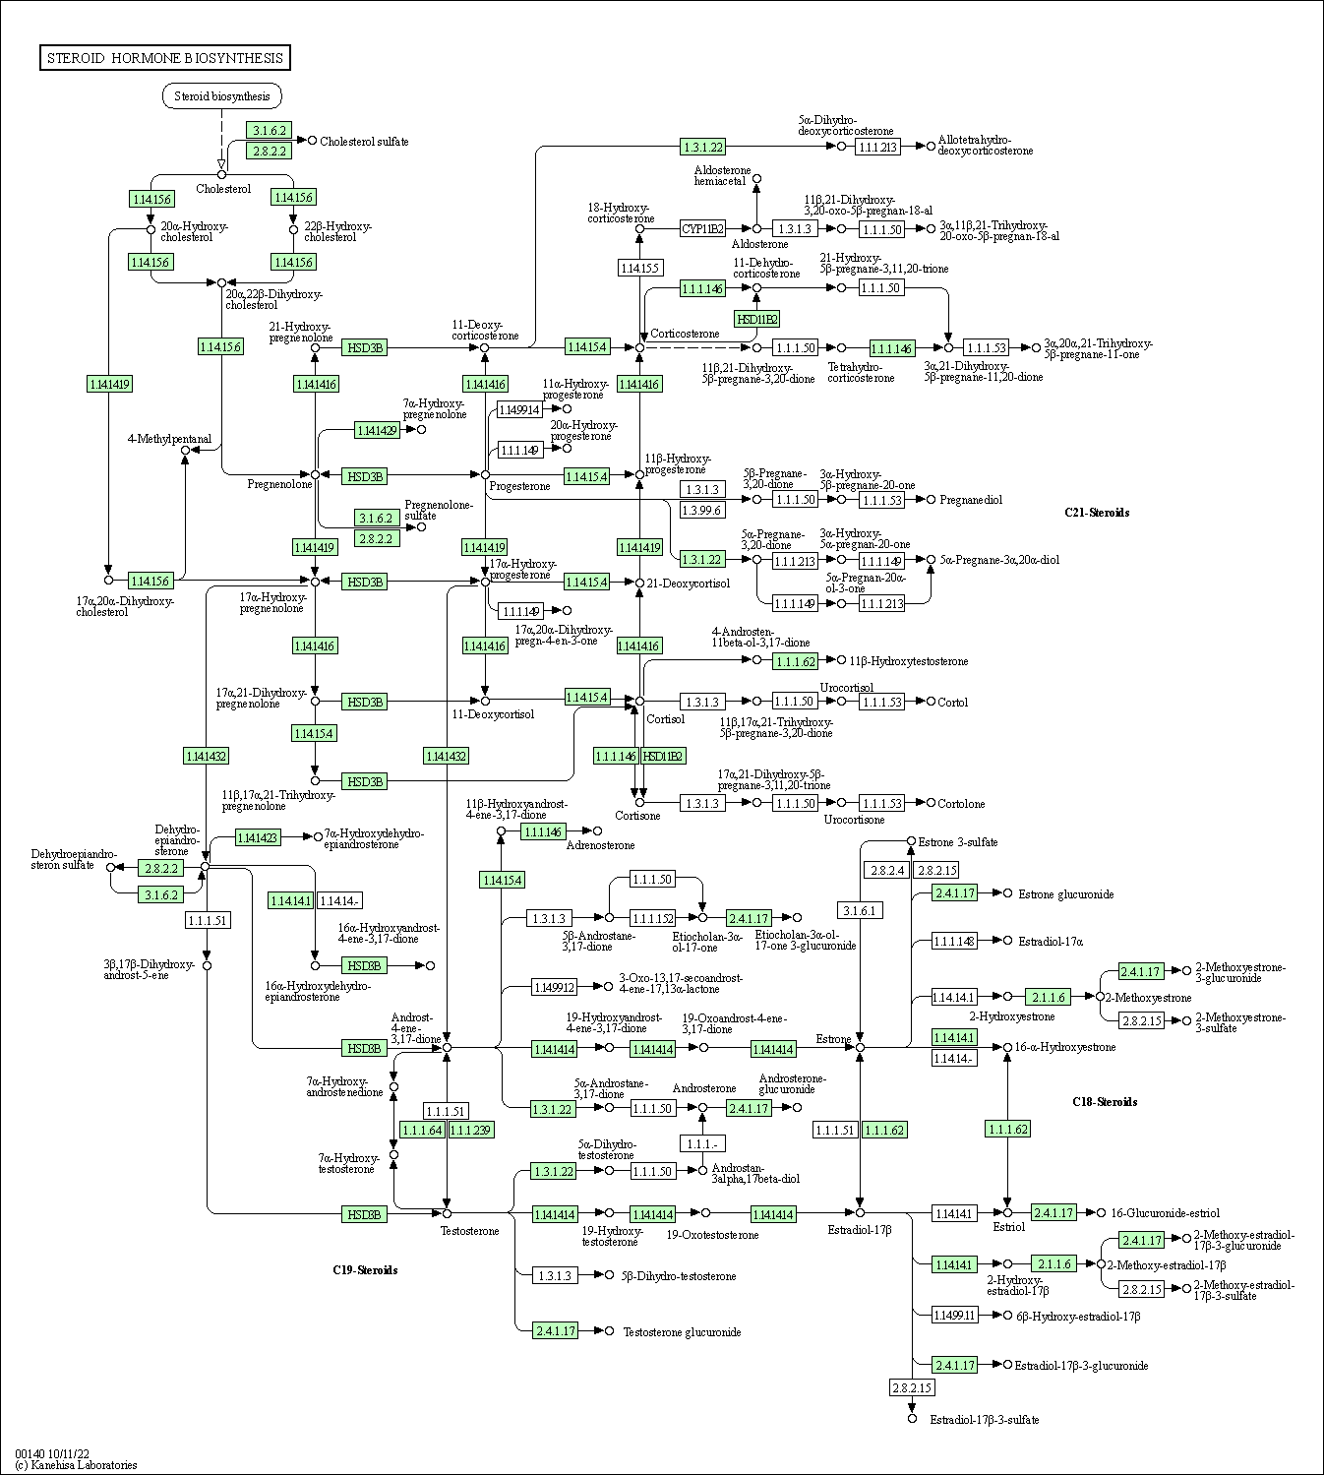
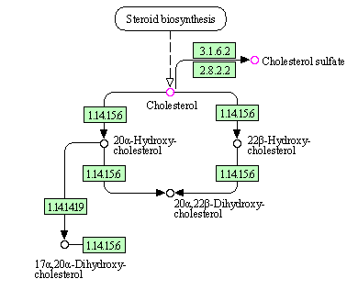
Steroid Hormone Biosynthesis
KEGG ID: dre00140
Contains:
Cholesterol Metabolism
https://www.kegg.jp/kegg-bin/show_pathway?dre00140

Slide 7
Comparisons WT vs. Mutants
Terpenoid Backbone Biosynthesis
(Mevalonate Pathway)
Steroid Biosynthesis
(Cholesterol Synthesis)
Steroid Hormone Biosynthesis
(Cholesterol Metabolism)

Slide 8
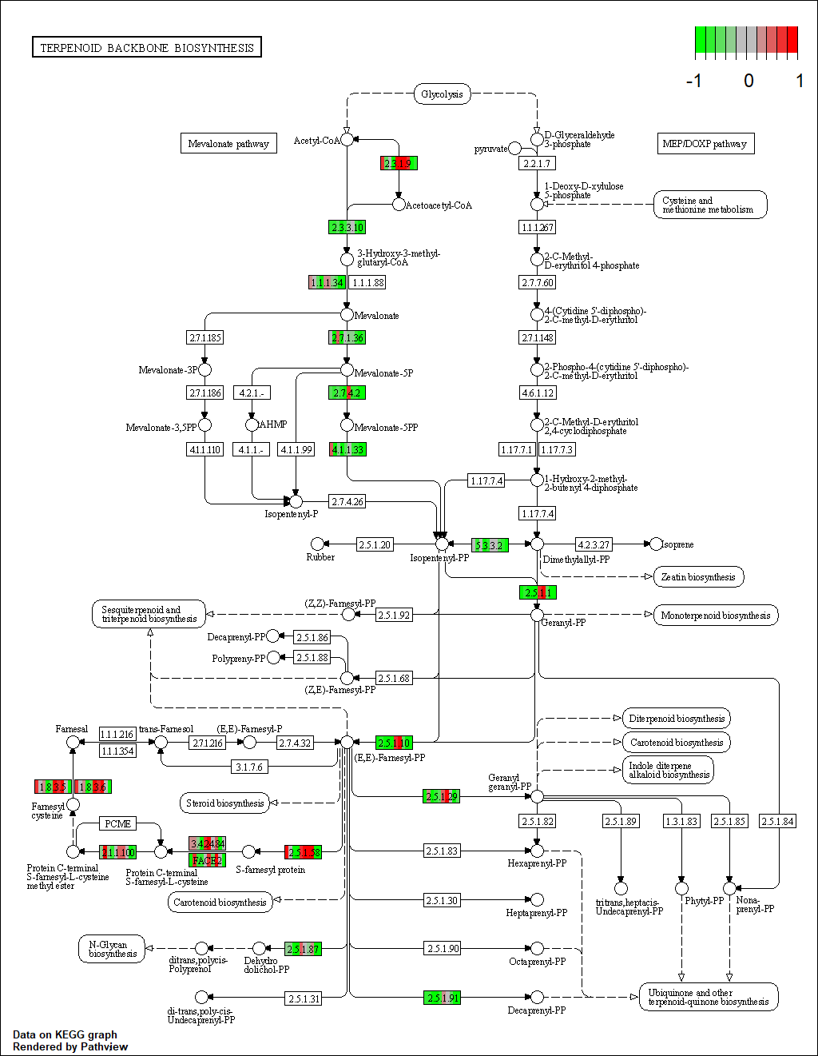
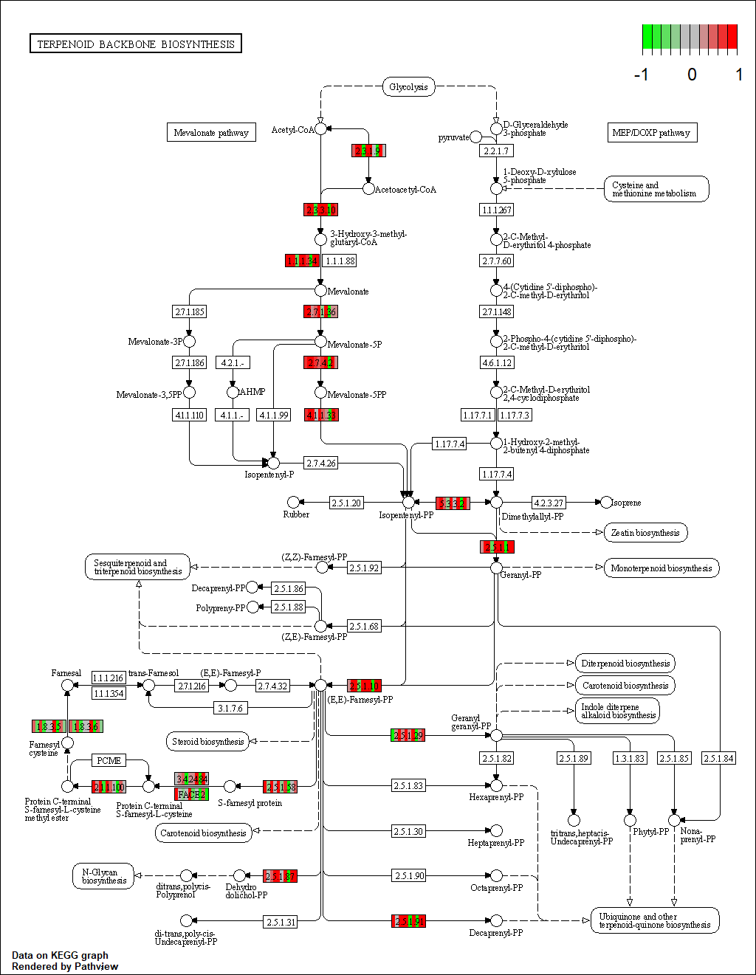
Terpenoid Backbone Biosynthesis
Wildtype
Mutant

Slide 9
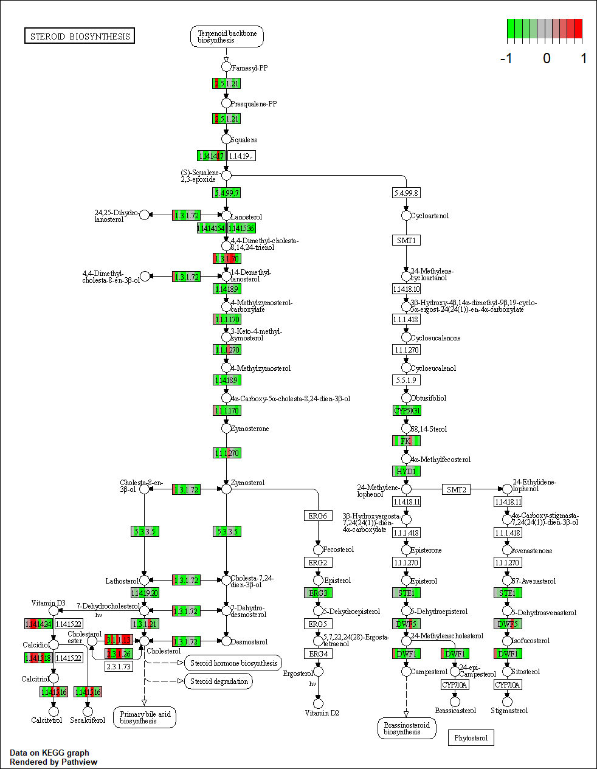
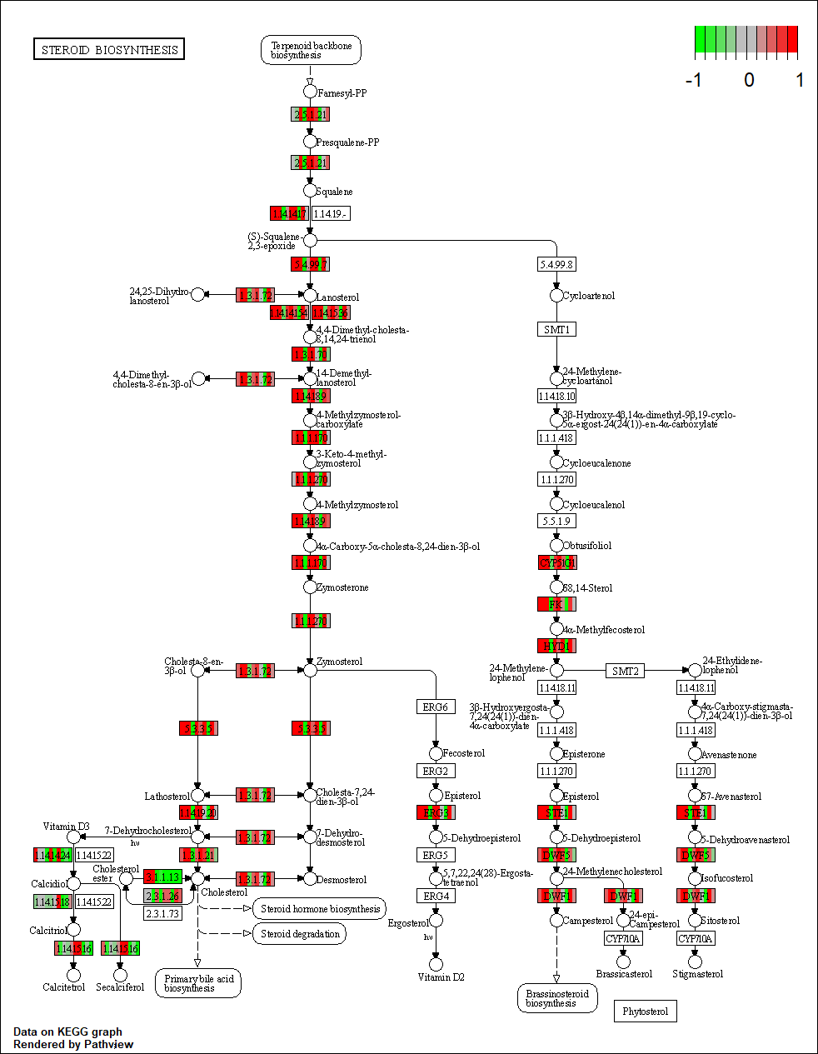
Steroid Biosynthesis
Wildtype
Mutant

Slide 10
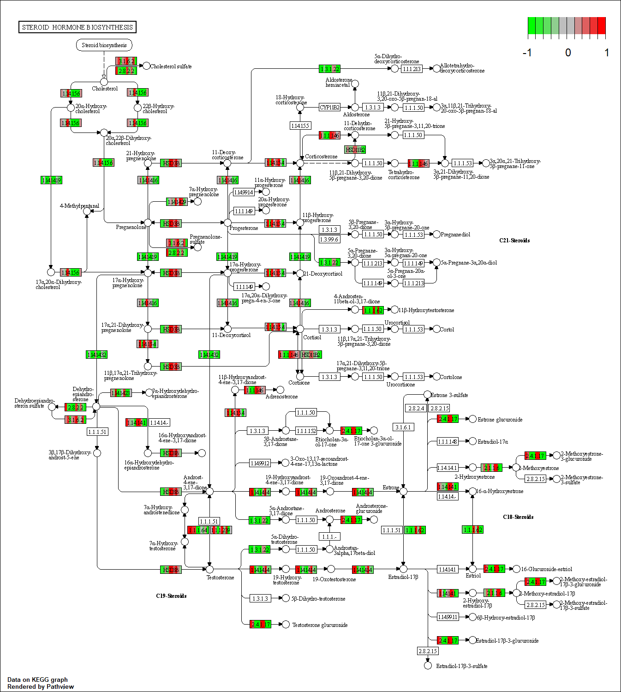
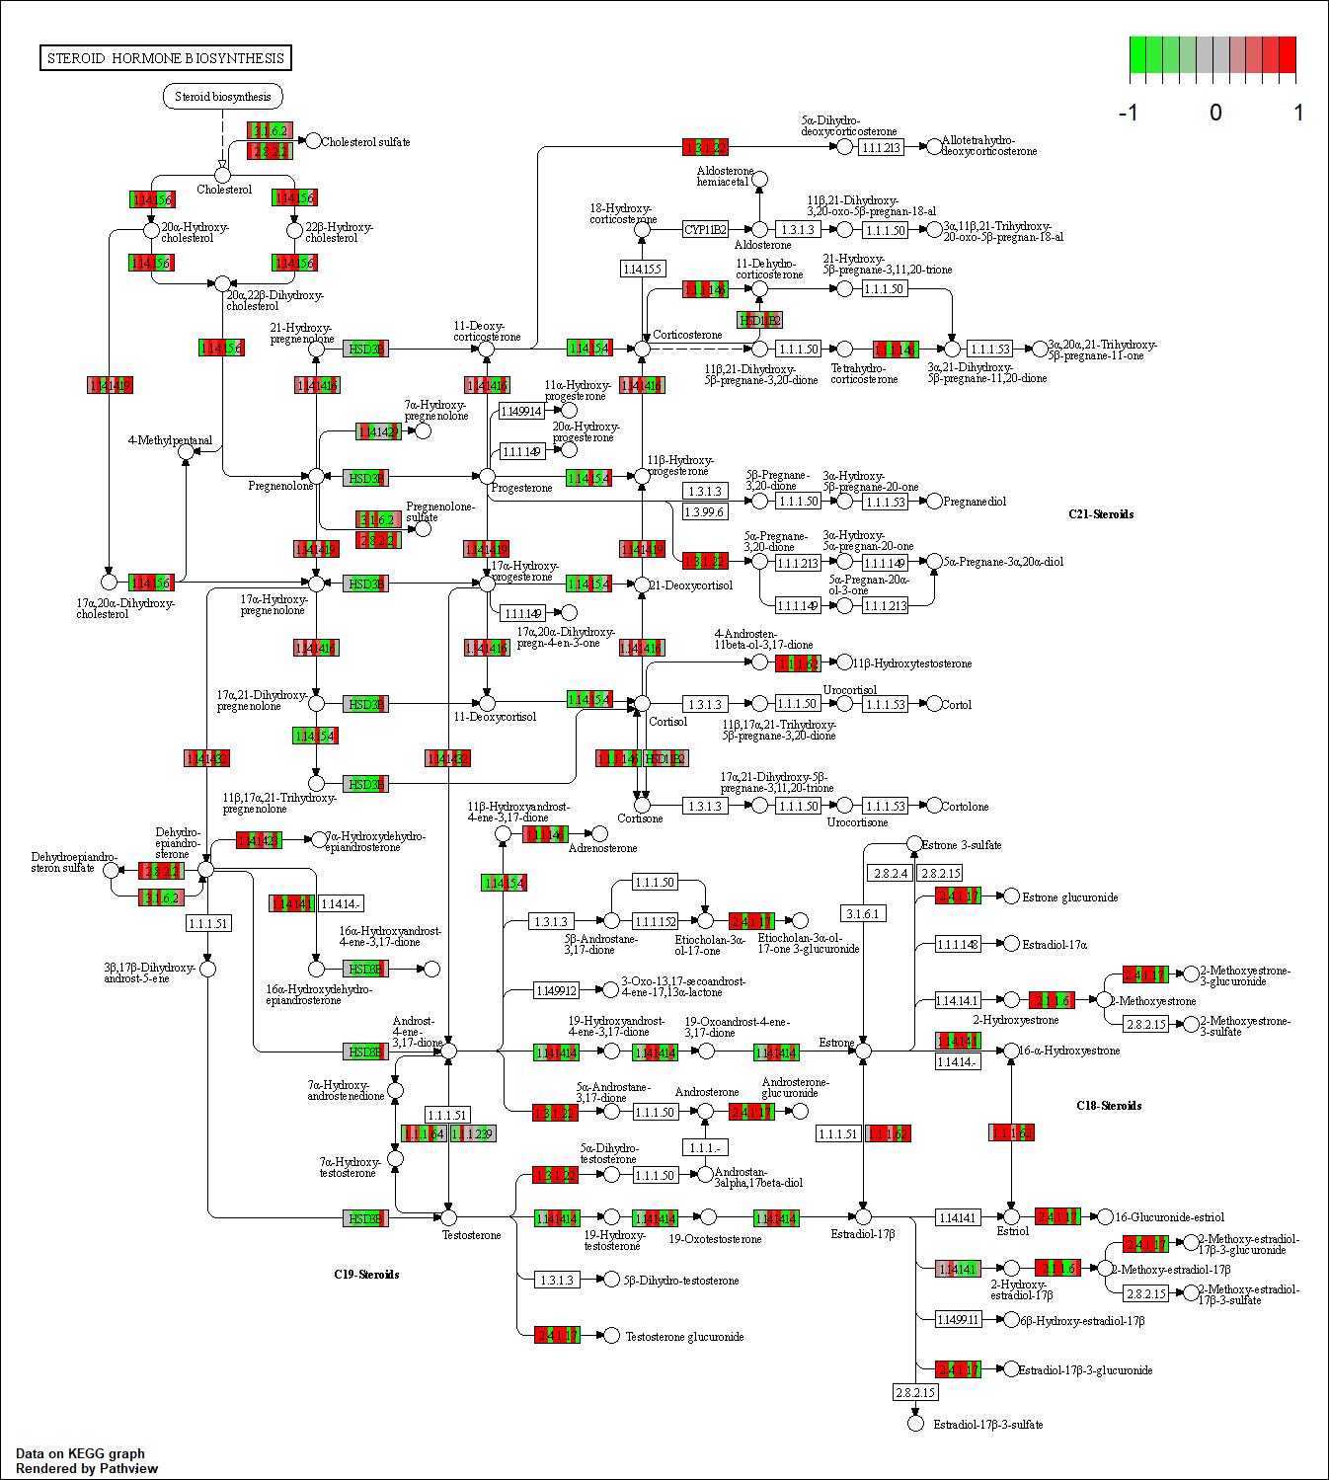
Steroid Hormone Biosynthesis
Wildtype
Mutant

Slide 11
Glycolysis and ATP Synthesis

Slide 12
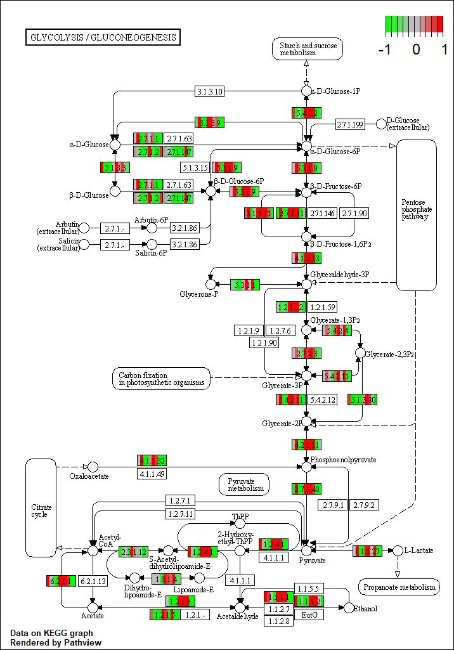
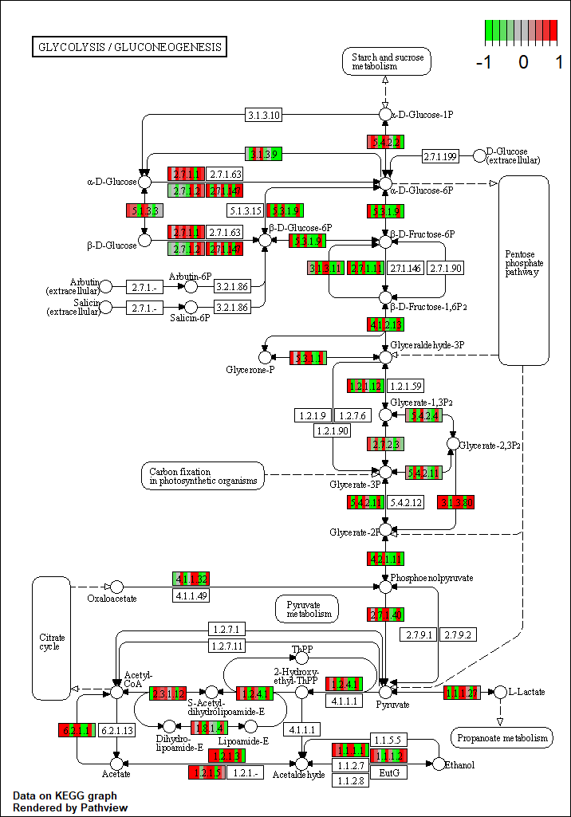
Glycolysis/ Glucogenesis
Wildtype
Mutant
KEGG ID: dre00010
Contains:
Starch and sucrose metabolism
Connects To:
Citrate cycle
https://www.kegg.jp/pathway/map=dre00010

Slide 13
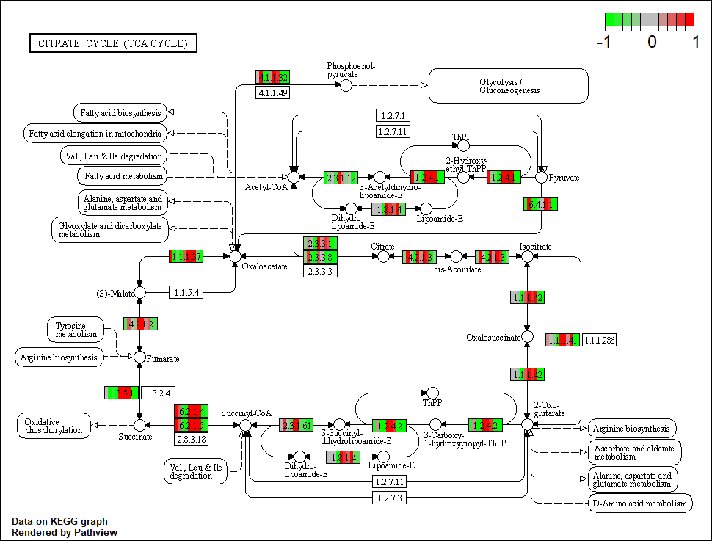
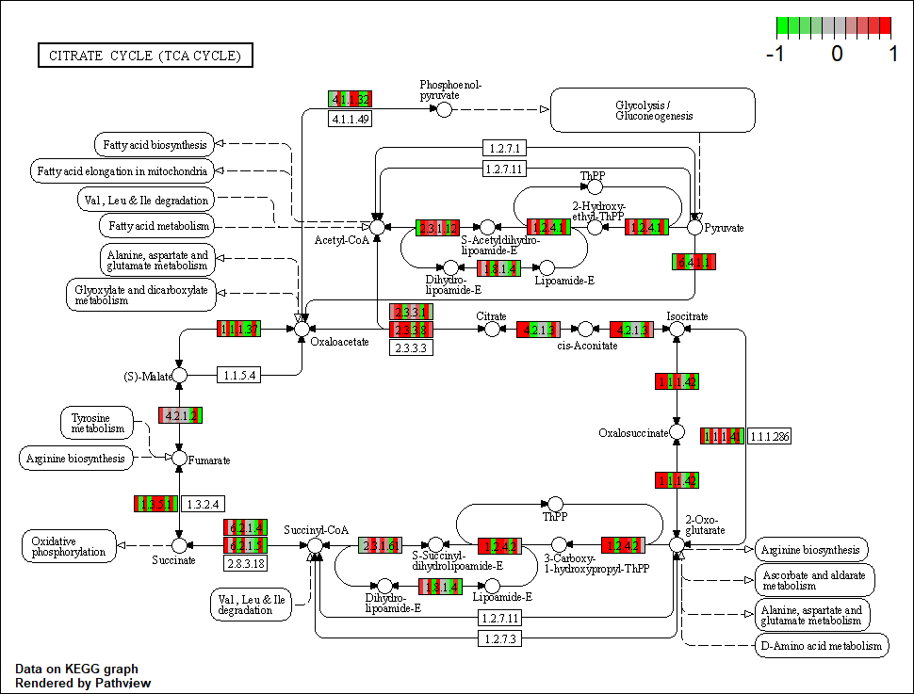
Citrate Cycle
KEGG ID: dre00020
Contains:
Gluconeogenesis
Connects To:
Oxidative Phosphorylation
https://www.kegg.jp/pathway/dre00020
Wildtype
Mutant

Slide 14
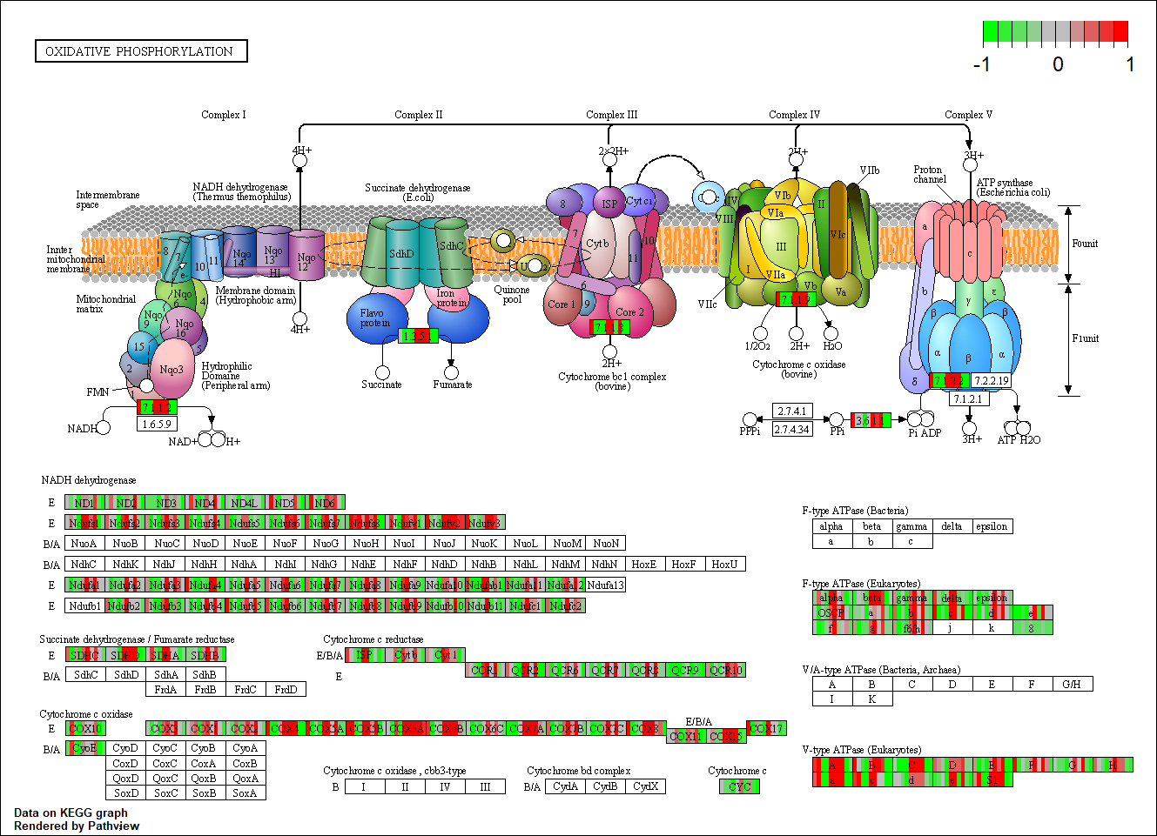
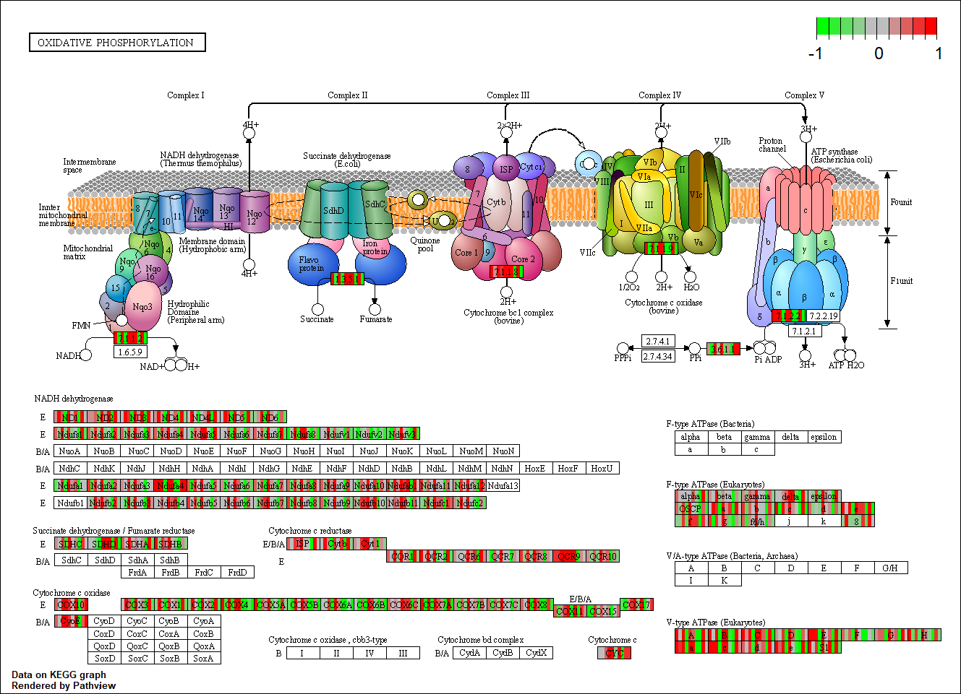
Oxidative Phophorylation
KEGG ID: dre00190
Contains:
ATP
https://www.kegg.jp/pathway/dre00190
Wildtype
Mutant

